Slide 1




Introduction to EEG and analysis with the FieldTrip toolbox
Marios Antonakakis
Institute for Biomagnetism and Biosignalanalysis, University of Münster, Germany
BACI, Bern, 29.08.2017

Slide 2
What is FieldTrip?
a MATLAB toolbox for the analysis of MEG, EEG and animal electrophysiology data
can import data from many different file formats
contains algorithms for spectral analysis, source reconstruction, statistics, connectivity, …

Slide 3
Outline
What kind of signals are generated in the brain
How do we record those signals using EEG
EEG preprocessing with FieldTrip
Summary

Slide 4
What kind of signals are generated in the brain
We measure the scalp potentials or fields associated with post-synaptic potentials (PSPs) in pyramidal neurons
These PSPs represent the exitatory and inhibitory input that these neurons receive
Usually we study this neuronal input following the presentation of a stimulus or following a cognitive event

Slide 5
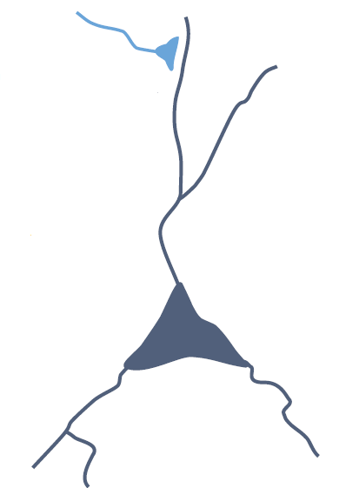
What generates the currents
pre-synaptic potential
post-synaptic potential

Slide 6
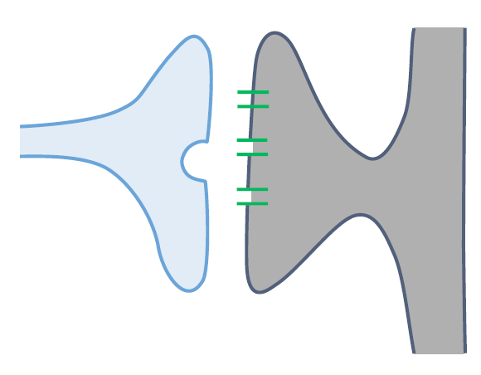
What generates the currents
pre-synaptic potential
Glu
Na⁺
^{AMPA}
post-synaptic potential
Notes:
Neurotransmiter realise

Slide 7
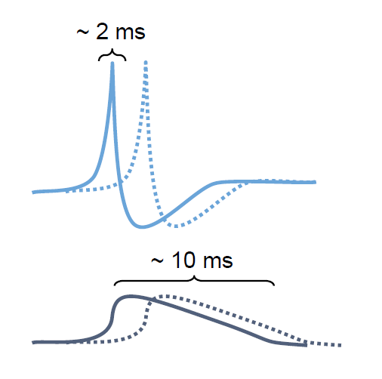
What generates the currents
Action Potential
exitatory or inhibitory
post-synapaptic potentials
Notes:
Much short Biphasing so it is hard to
Post synaptic - Much longer and they are monophasing

Slide 8
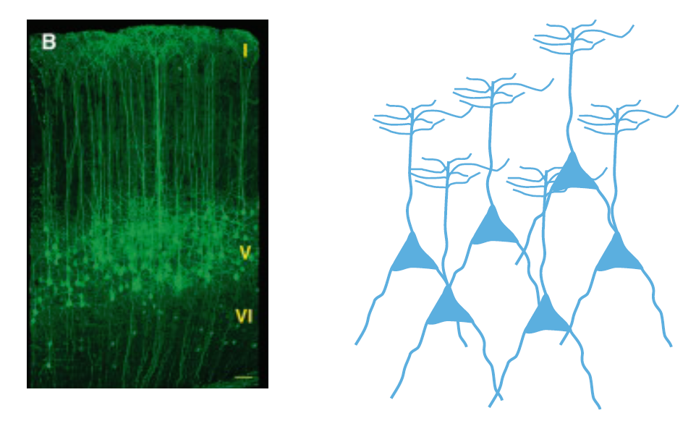
What generates the currents
Notes:
What we measure is actually Neurons that are oriented in parallel
Vertical orientation and perpanticular to the scalp

Slide 9
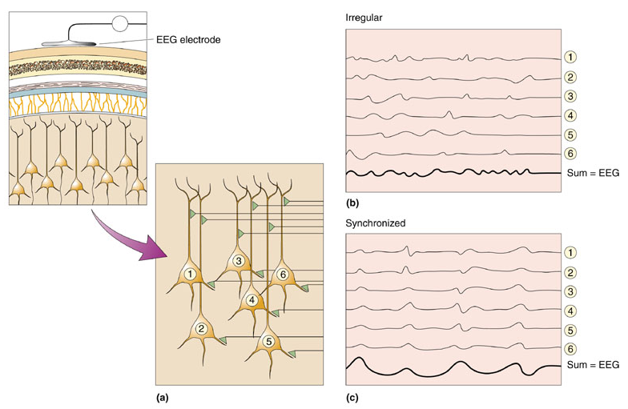

How do we record those signals using EEG (ElectroEncephaloGram)
Many neurons need to sum their activity in order to be detected by EEG electrodes. The timing of their activity is crucial. Synchronized neural activity produces larger signals.

Slide 10
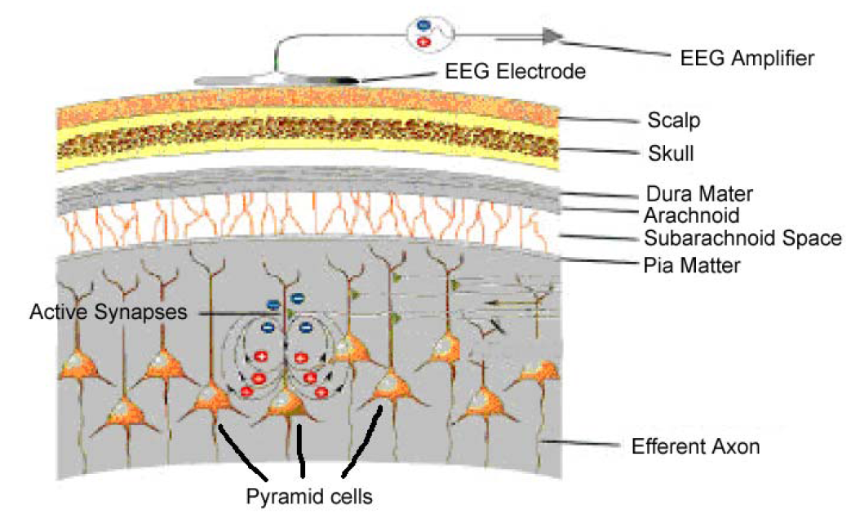
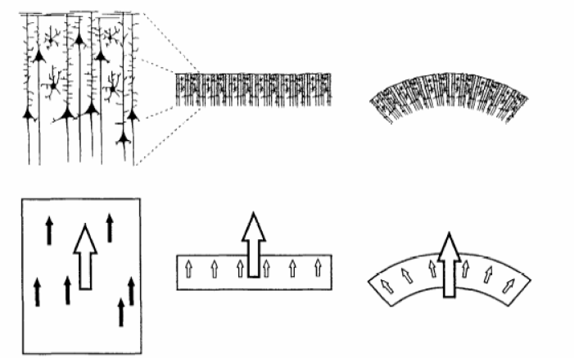
How do we record those signals using EEG (ElectroEncephaloGram)
There are perhaps 10⁵ neurons under a mm² of cortical surface.
EEG electrodes measure the space-averaged activity of >10⁷ neurons.
A µvolt signal will only be detected if pyramidal neurons are synchronously activated and many small dipoles are combined.
Equivalent current dipoles

Slide 11
How do we record those signals using EEG (ElectroEncephaloGram)
Strong points of EEG
  Temporal resolution (~1 ms)
  Characterize individual components of ERP
  Oscillatory activity
  Disentangle dynamics of cortical networks
Weak points of EEG
  Measurement on outside of brain
  Overlap of components
  Low spatial resolution

Slide 12
EEG preprocessing with FieldTrip
Reading raw data
Frequency spectrum elimination around frequencies of interest
Artefact rejection and elimination
Single trial estimation
… Further analysis according to our interests

Slide 13
EEG preprocessing with FieldTrip
Reading raw data
  Trial definition
    Specify our own function
Frequency spectrum elimination around frequencies of interest
Artefact rejection and elimination
Single trial estimation
… Further analysis according to our interests

Slide 14
Trial definition
Defining the trials, i.e. the pieces of data that will be read in for pre‐processing. Trials are defined by their begin and end sample in the data file and each trial has an offset that defines where the relative t=0 point (usually the point of the trigger) is for that trial.
Trial definition before pre‐processing allows us to save processing resources.

Slide 15
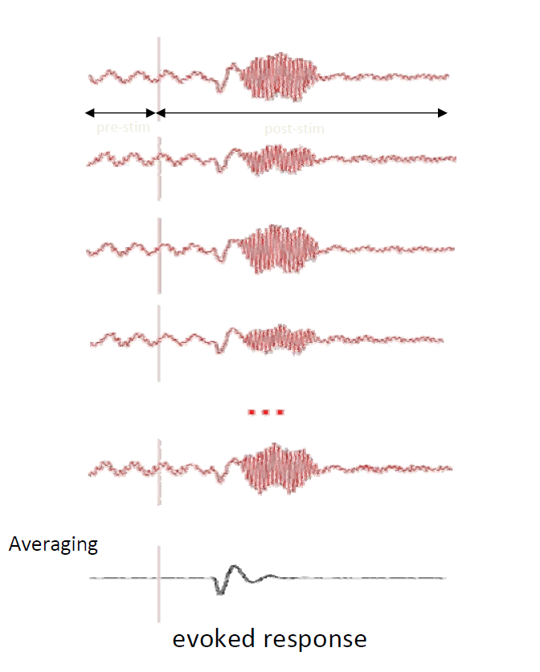
Why do we need triggers?
pre-stim
post-stim

Slide 16
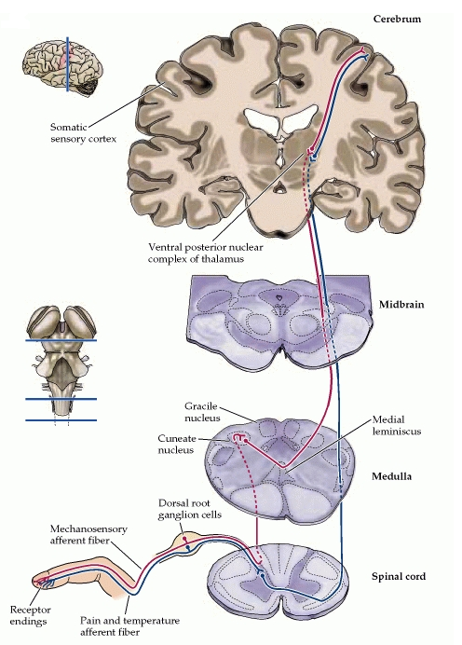
Anatomy and physiology of the somatosensory system
specific (lemniscal) system
  fast (minimally 3 neurons)
  first-order neurons: dorsal root ganglia
  second-order neurons: cuneate nuclei
  third-order neurons: thalamus
unspecific (extra-lemniscal) system
  slower
  diffuse cortical projection
  possibly affects later SEP/SEF-components

Slide 17
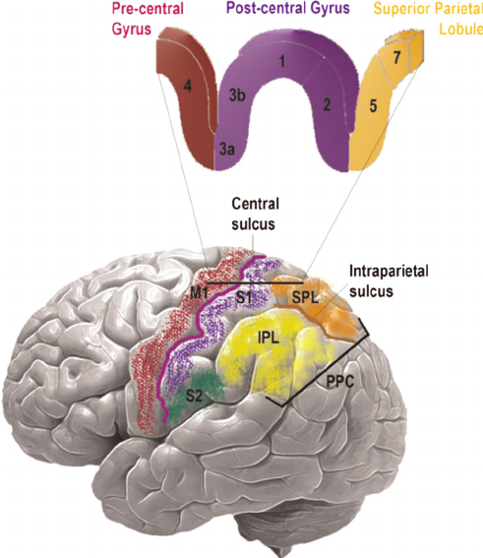
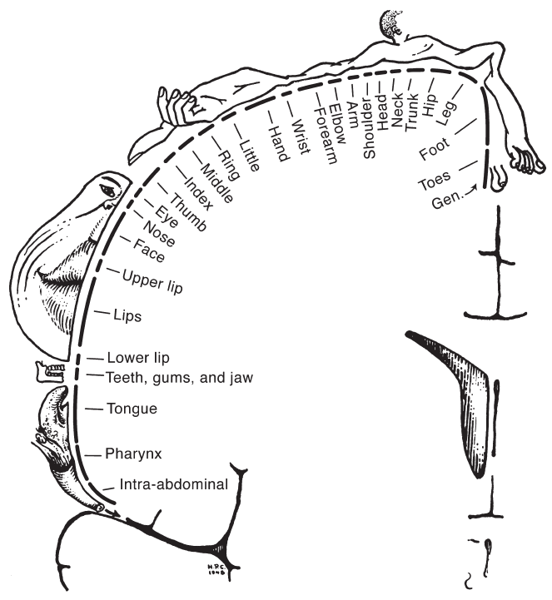
Anatomy and physiology of the somatosensory system
primary somatosensory cortex (SI)
  postcentral gyrus
  Brodmann areas 3, 1, 2
  sensory “homunculus“
secondary somatosensory cortex (SII)
  Brodmann areas 40, 43

Slide 18
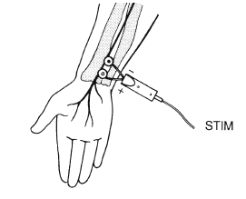
Electric stimulation of median nerve
median nerve stimulated at wrist
lowest strength that achieves twitching of thumb
advantages | limitations
large, robust signal high frequency | artefacts uncomfortable (children,…?) “unnatural“ stimulus

Slide 19
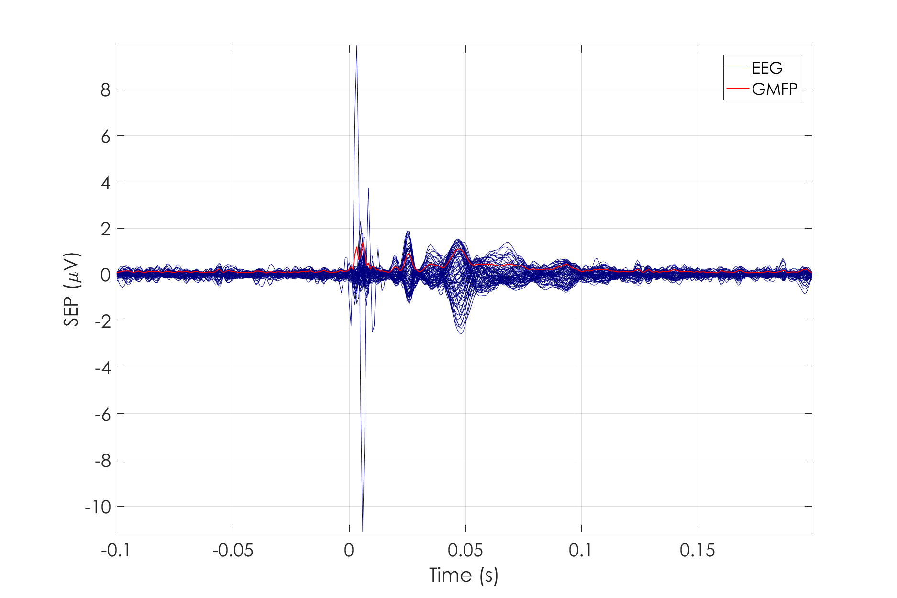
Example dataset

Slide 20
EEG preprocessing with FieldTrip
Reading raw data
  Trial definition
    Specify our own function
  Baseline correction
Frequency spectrum elimination around frequencies of interest
Artefact rejection and elimination
Single trial estimation
… Further analysis according to our interests

Slide 21
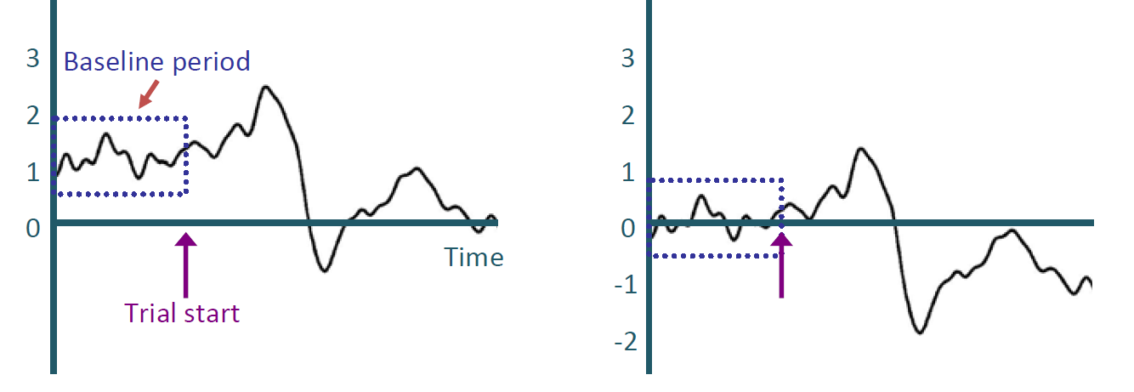
Baseline Correction
Before BLC
After BLC
Baseline correction
Calculate the mean of the baseline period
Subtract the mean from the rest of the data

Slide 22
EEG preprocessing with FieldTrip
Reading raw data – ft_preprocessing
  Trial definition – ft_definetrial, ft_refinetrial
    Specify our own function – cfg.trialfun = ‘foo’
  Baseline correction – cfg.demean = ‘yes’
Frequency spectrum elimination around frequencies of interest
Artefact rejection and elimination
Single trial estimation
… Further analysis according to our interests

Slide 23
EEG preprocessing with FieldTrip
Reading raw data
  Trial definition
    Specify our own function
  Baseline correction
Frequency spectrum elimination around frequencies of interest
  dft filter, low‐pass/high‐pass filters
Artefact rejection and elimination
Single trial estimation
… Further analysis according to our interests

Slide 24
Data filtering
Power Line Noise (PLN)
distortion of EEG signals
reduce quality and convolute the interpretations of the data

Slide 25
Data filtering
Filtering - elimination of the original frequency spectrum

Slide 26
EEG preprocessing with FieldTrip
Reading raw data
  Trial definition
    Specify our own function
  Baseline correction
Frequency spectrum elimination around frequencies of interest
  dft filter, low‐pass/high‐pass filters
  ft_preprocessing, cfg.dftfilter = 'yes‘ or cfg.hpfilter = 'yes‘ or cfg.lpfilter = 'yes'
Artefact rejection and elimination
Single trial estimation
… Further analysis according to our interests

Slide 27
EEG preprocessing with FieldTrip
Reading raw data
  Trial definition
    Specify our own function
  Baseline correction
Frequency spectrum elimination around frequencies of interest
  dft filter, low‐pass/high‐pass filters
Artefact rejection and elimination
  Visual inspection
  Independent Component Analysis
Single trial estimation
… Further analysis according to our interests

Slide 28
Typical artefacts
Ocular artefacts
Cardiac artefacts
Power Line Noise
Notes:
The electric potentials created during saccades and blinks can be orders of magnitude larger than the electroencephalogram (EEG)
and can propagate across much of the scalp, masking and distorting brain signals.

Slide 29
How to detect and eliminate artefacts
Visual inspection
Direct removal or correction
Independent Component Analysis – ICA
Estimation of the independent components (ICs)
Reject artefact ICs
Back project the data by the remaining artefact-free ICs

Slide 30
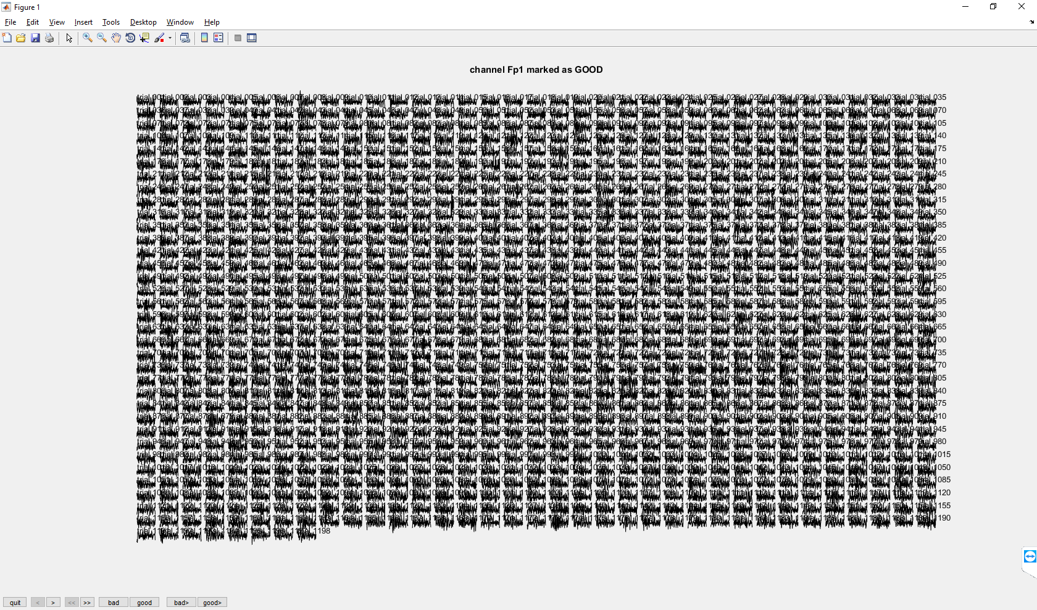
Bad trials/channels
Detect them using visually inspection (ft_rejectvisual, cfg.method = ‘channel’)
Remove from the rest of the analysis, (ft_databrowser, ft_channelselection, ft_selectdata)
Repair using neighbor channels – (ft_databrowser, ft_channelrepair)

Slide 31
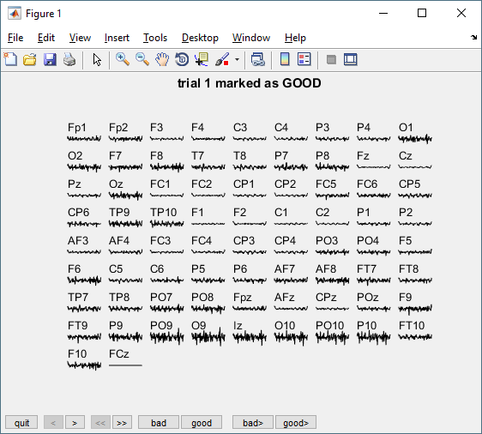
Bad trials/channels
Detect them using visually inspection (ft_rejectvisual, cfg.method = ‘trial’)

Slide 32
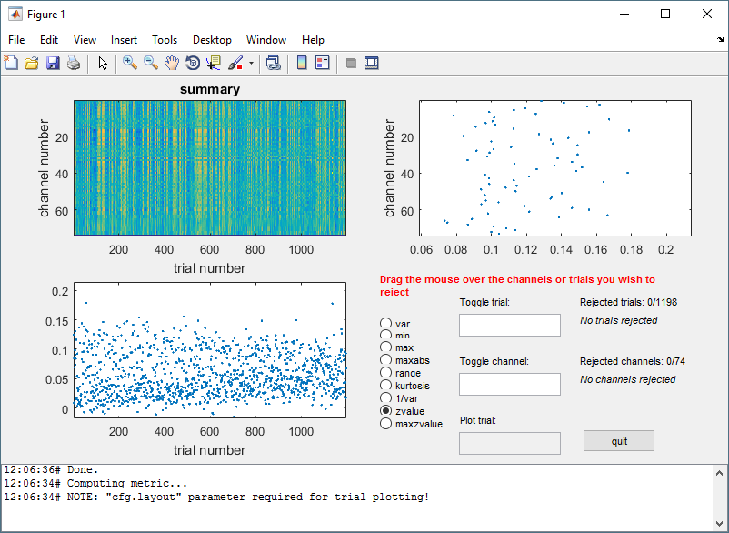
Bad trials/channels
Detect them using visually inspection
ft_rejectvisual,
cfg.method = ‘summary’,
cfg.metric = ‘…’

Slide 33
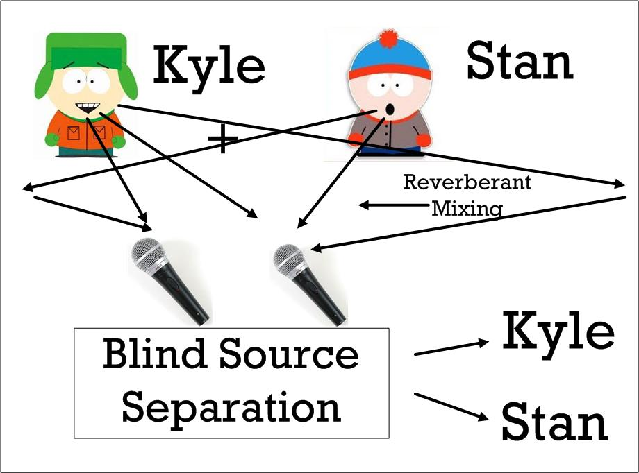
Reject artefact using ICA
mpla mpla
mpla mpla
Independent Component Analysis – ICA
Estimation of ICs through information theory
  iterative minimization of mutual information
Preprocessing steps
  data whitening using principal component analysis (uncorrelated data, dimensionality reduction)
ICA

Slide 34
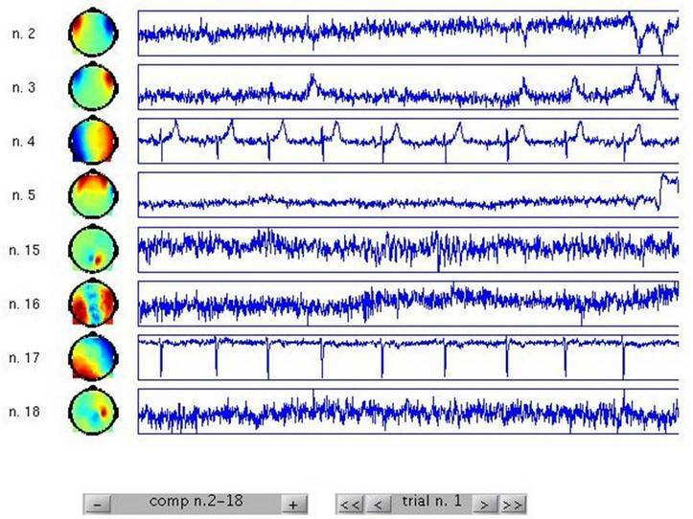
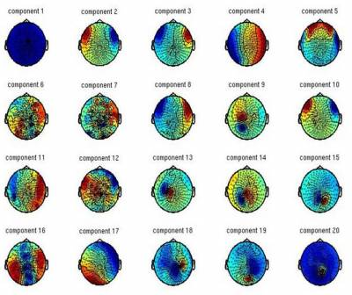
Reject artefact using ICA
ft_componentanalysis,
  cfc.method = ‘runica’
  cfc.runica.pca
ft_databrowser, ft_topoplotIC
ft_rejectcomponent
Notes:
Run two times ica to see if there is still remaining non cerebral information in the data

Slide 35
EEG preprocessing with FieldTrip
Reading raw data
  Trial definition
    Specify our own function
  Baseline correction
Frequency spectrum elimination around frequencies of interest
  dtf filter, low‐pass/high‐pass filters
Artefact rejection and elimination
  Visual inspection
  Independent Component Analysis
Single trial estimation
  average trials for each channel - ft_timelockanalysis, ft_globalmeanpower
… Further analysis according to our interests

Slide 36
Single trial estimation
trial 1
trial 2
…
trial n-1
trial n
…individual trials

Slide 37
Global mean field power

Slide 38
Dataset for analysis
  A right-handed participant with
    74 channel EEG (plus additional 6 EOG)
    electric wrist stimulation of the median nerve
    stimulus duration: 200ms, ISI: 350 to 450ms
    Scanning of T1w- Magnetic Resonance Images (MRI) with voxels of 1 x 1 x 1 mm³ (MAGNETOM 3.0T Siemens Medical Solutions)

Slide 39
Summary
  What kind of signals are generated in the brain
  How do we record those signals using EEG
  EEG preprocessing with FieldTrip
hands-on
  Selecting segments of data
  Reading and preprocessing
  Averaging and plotting

Slide 40

Thank you for your attention!!!
Questions?

